Slide 1
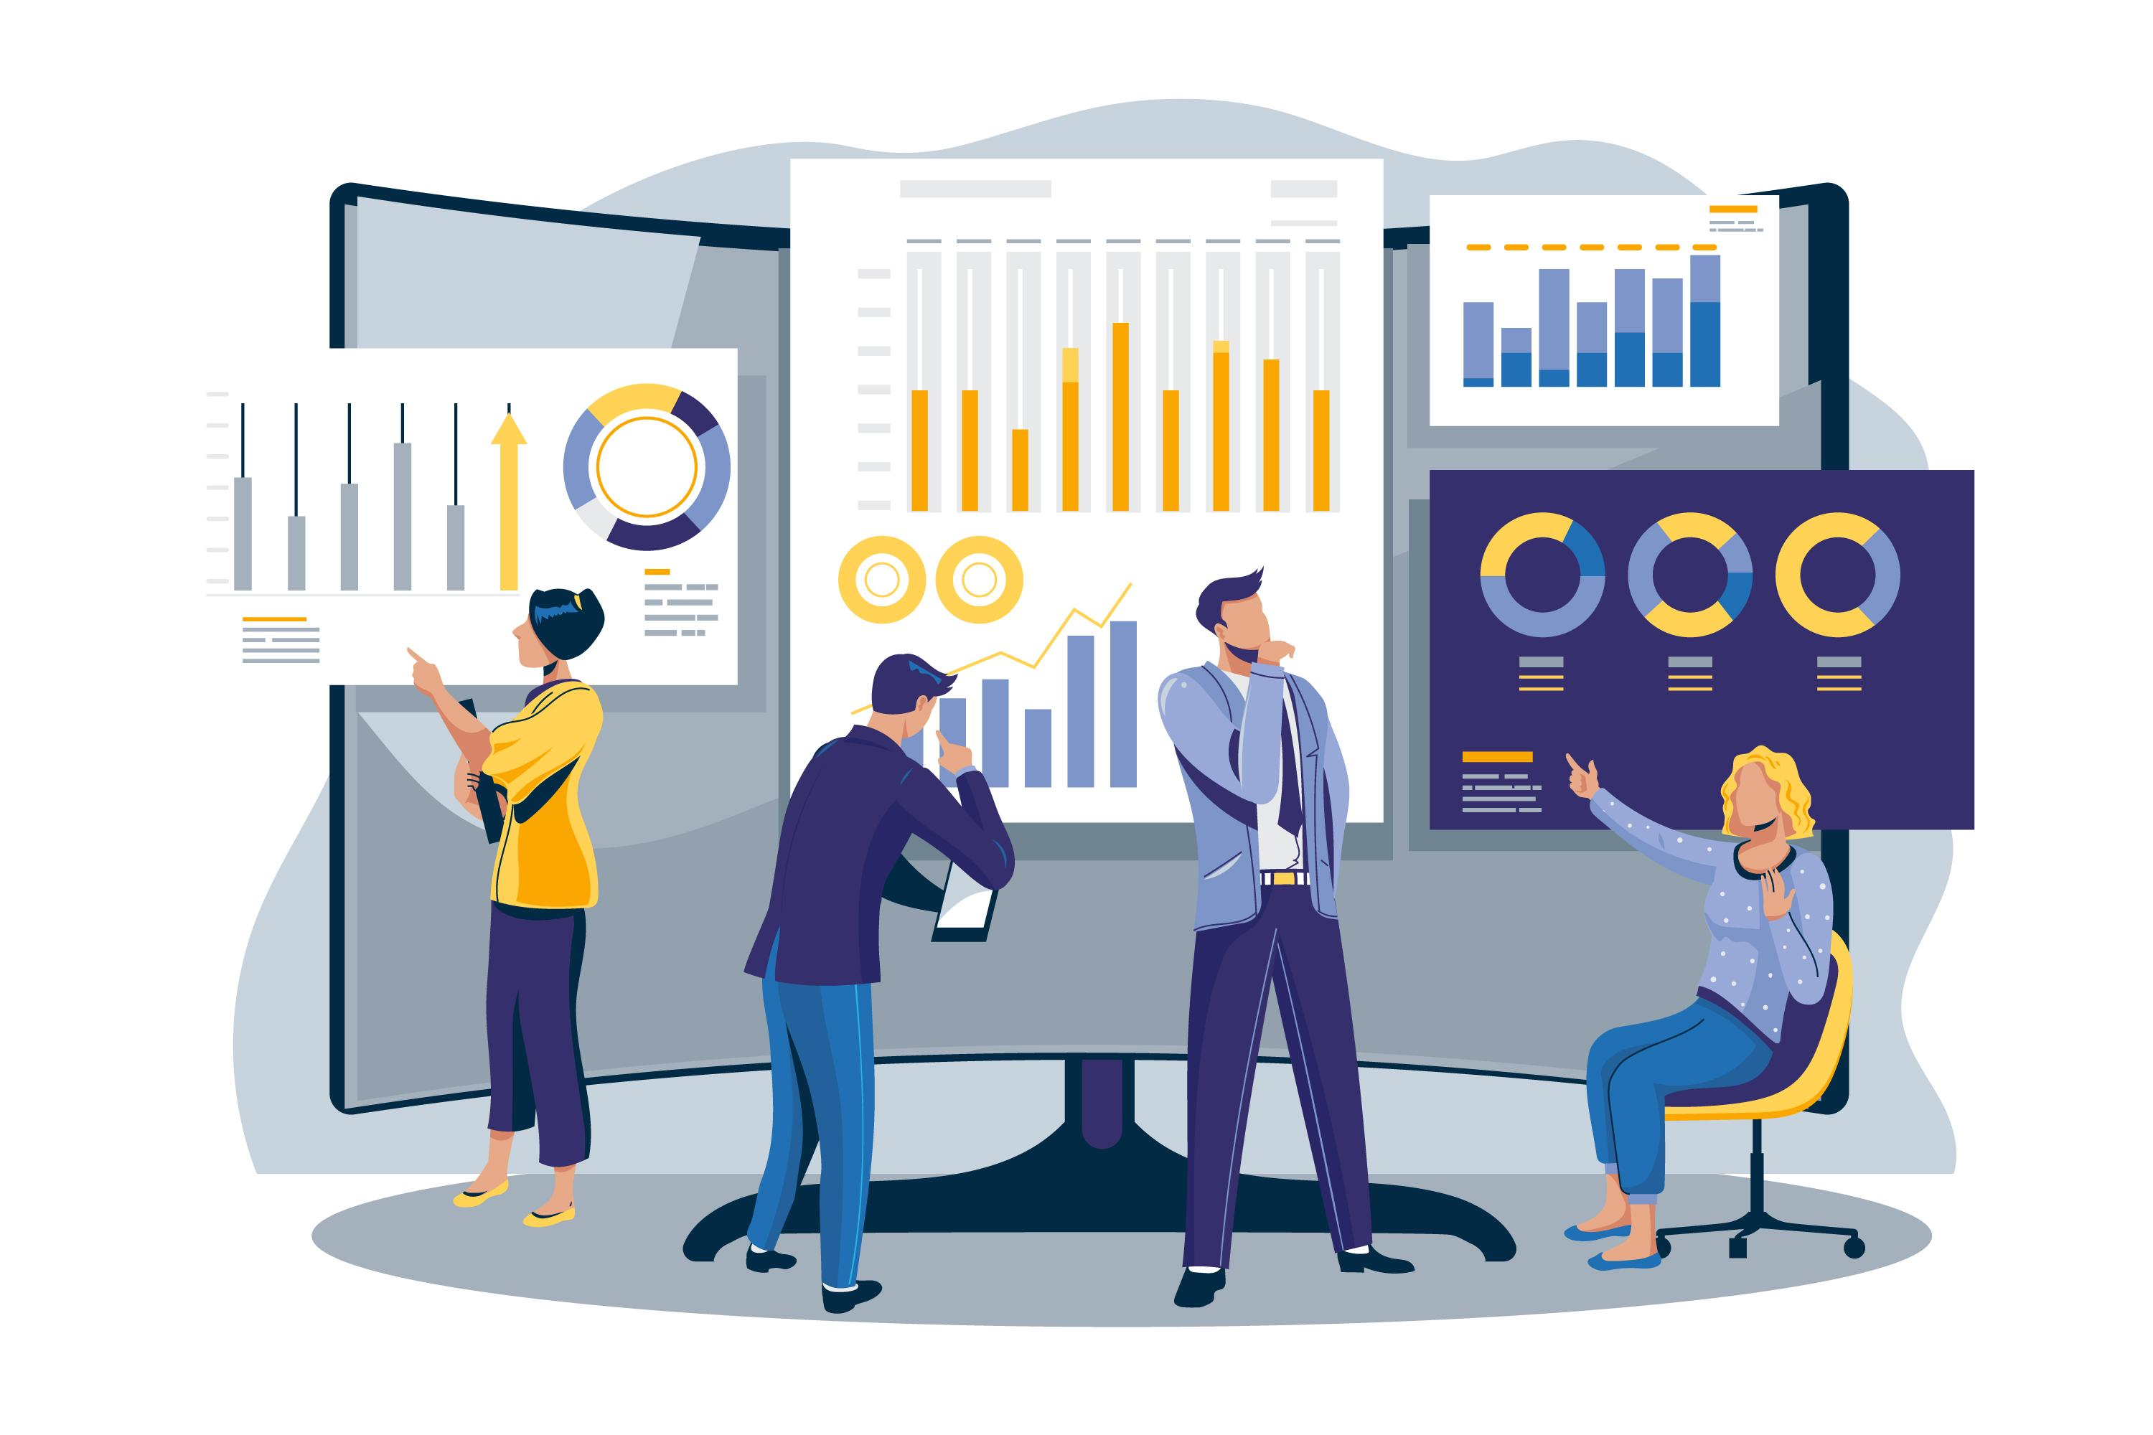
Customer Churn Prediction

Slide 2
Introduction
What is Customer Churn?
When a customer stops using a company’s product or service.
Why is it important?
Retaining customers is more cost-effective than acquiring new ones.

Slide 3
Problem Statement
Businesses lose millions due to customer churn.
Need for early detection of customers likely to churn.
Goal: Build a predictive model to identify churn risk.

Slide 4
Dataset Overview
Dataset Used: Telco Customer Churn
Dataset
Features:
Customer ID
Demographics
Services
Billing
Target: Churn (Yes/No)

Slide 5
Data Preprocessing
Handled missing values (e.g., TotalCharges)
Categorical encoding (LabelEncoder / OneHotEncoding)
Feature scaling (MinMax or StandardScaler)
Train-Test Split (80:20)

Slide 6
Exploratory Data Analysis (EDA)
Correlation heatmap
Churn distribution
Churn vs contract type, tenure, charges
Insights:
Month-to-month contracts show higher churn
Low tenure customers more likely to churn

Slide 7
Model Building
Algorithms used:
Logistic Regression
Random Forest
XGBoost
Cross-validation and handling imbalance (SMOTE / Class Weights)

Slide 8
Model Evaluation
Metrics used:
Accuracy
Precision / Recall
F1-Score
ROC-AUC
Confusion Matrix
Best model: XGBoost (e.g., 85% accuracy)

Slide 9
Feature Importance
Top features:
Contract Type
Tenure
Monthly Charges
Internet Service
Visualize with bar graph or SHAP values

Slide 10
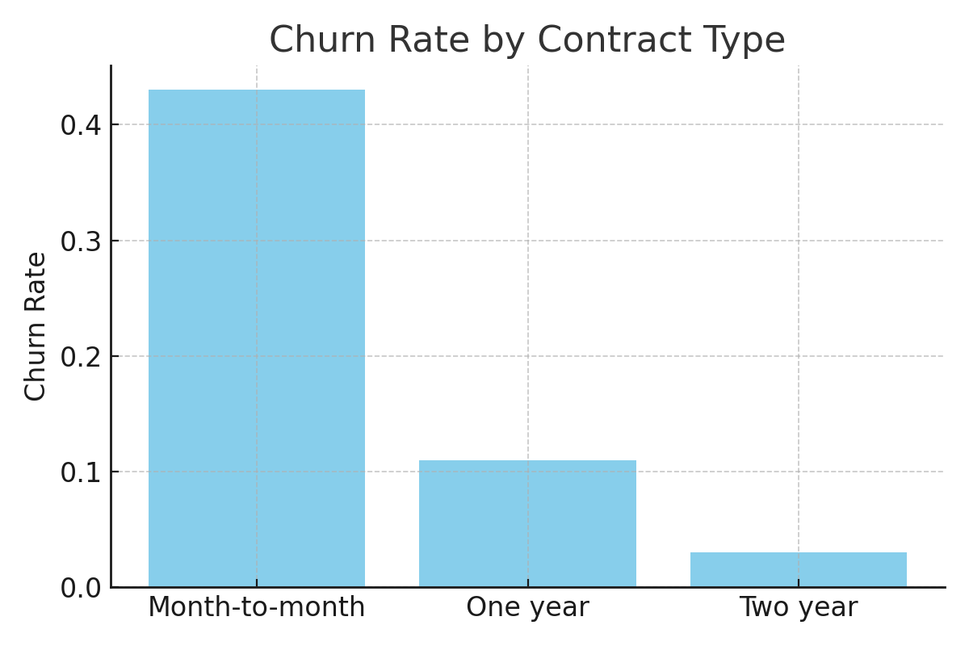
Churn Rate by Contract Type

Slide 11
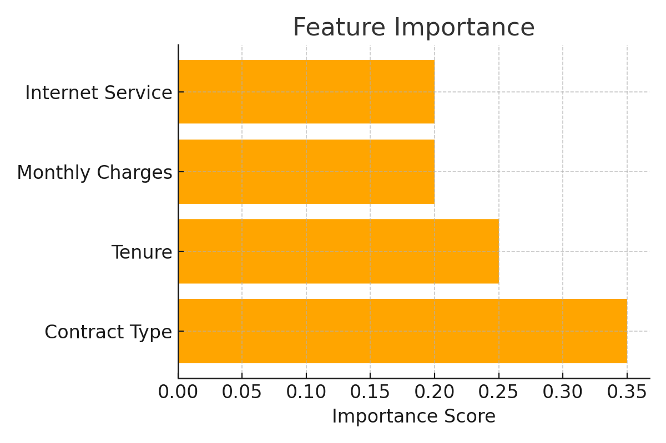
Feature Importance

Slide 12
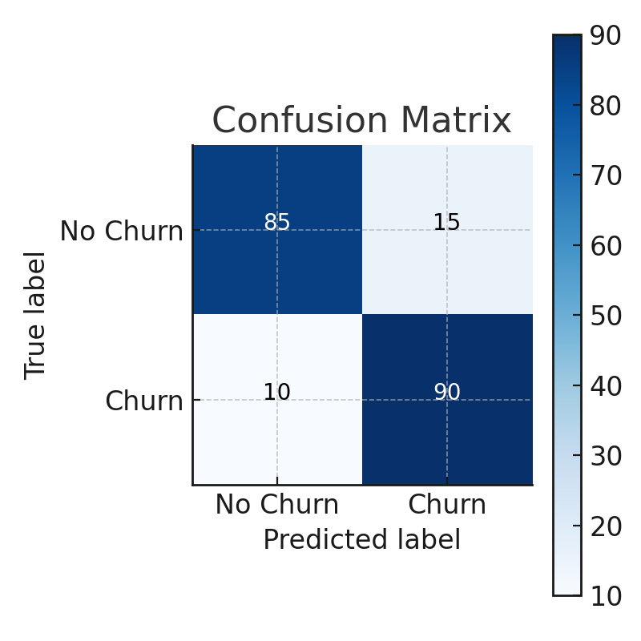
Confusion Matrix

Slide 13
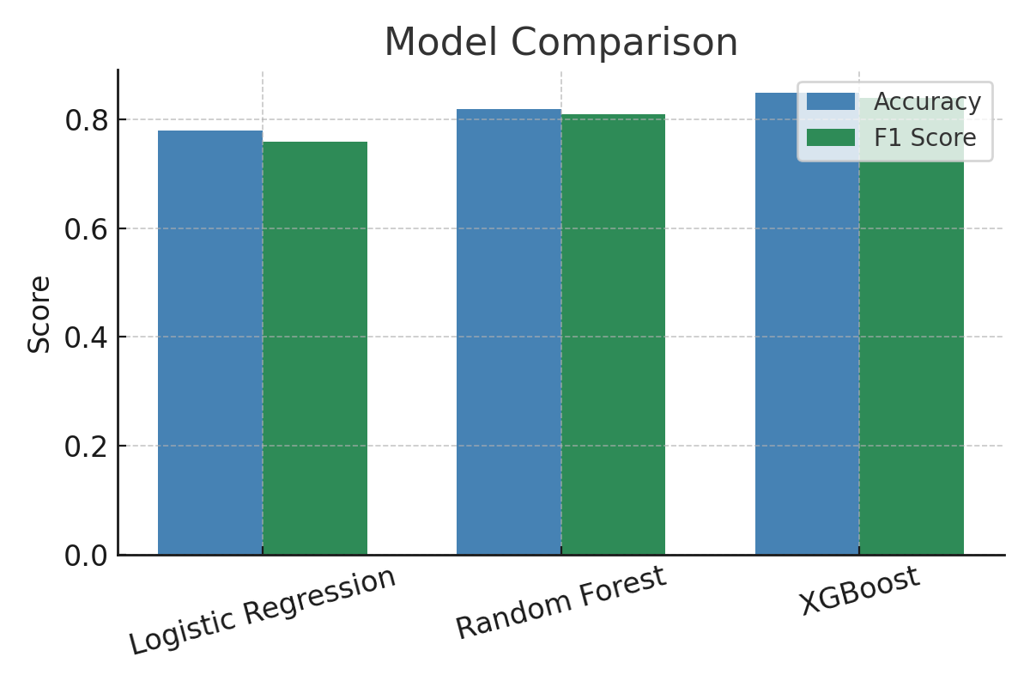
Model Comparison

Slide 14
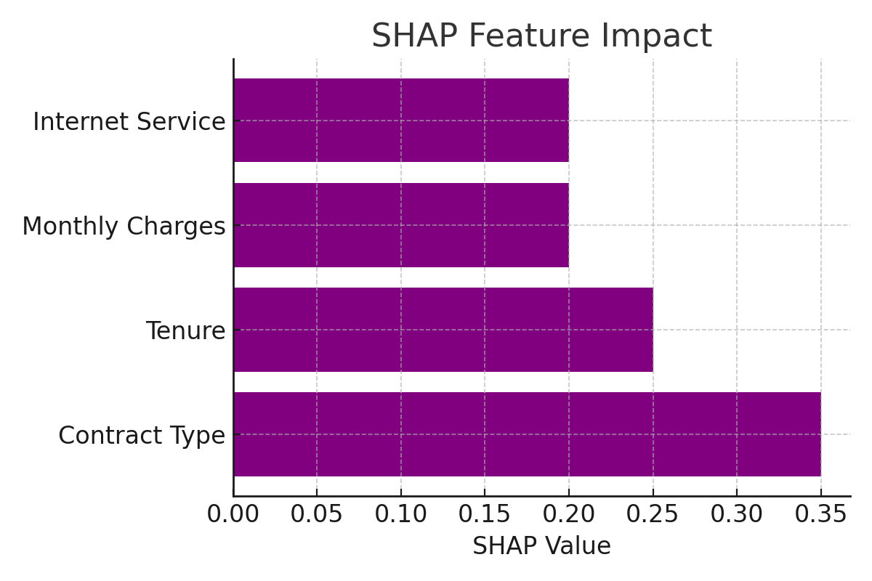
SHAP Value Feature Impact

Slide 15
Business Impact
Early churn detection → targeted retention offers
Personalized campaigns → reduced churn
Increased customer lifetime value (CLV)

Slide 16
Conclusion & Future Work
Conclusion:
ML can predict churn and help retain customers
Future Work:
Real-time deployment
Dashboard integration
Deep learning models

Slide 17
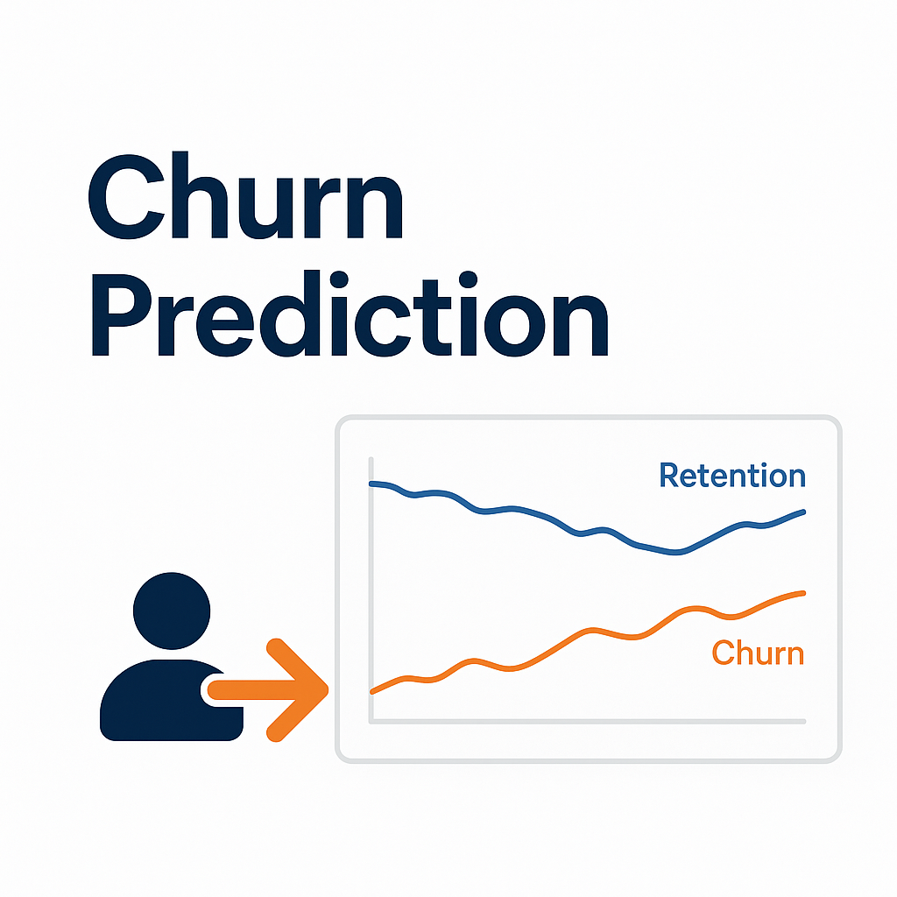
THANK YOU

